Slide 1
NewPOS 6.5 Training – Restaurant Terminology and Topology Overview
Training QA For McDonald’s
Author: Edgar Cortez

Slide 2
Overview
Introduction
NewPOS® is a Product Suite designed to offer an environment to customize and deploy a QSR (Quick Service Restaurant) Point of Sale (POS) global solution. Before you continue, it is strongly suggested that you read the NewPOS 6.1 Overview/Crew Member Manual to understand the high level picture of the NewPOS solution suite. This document will cover the following topics:
• Overview of the basic terminology
• Overview of main POS operations
• Overview of NewPOS Topology
Notes:
Overview of the topics for the class

Slide 3
Terminology
This section will present you with a few concepts and procedures regarding order taking and sales on a NewPOS 6.1 environment. The information presented herein is for general understanding of the processes involved. Fully detailed procedures are explained later on this manual.
Business Day
A Business Day is defined as a normal working day at the restaurant and has nothing to do with any particular weekday. Two events delimit a Business Day: the Store Open and the Store Close procedures, which must be performed by the restaurant manager. The Store Open procedure puts the POS at work. The Crew member cannot yet sell items at this point. The POS Close and Final Daily Close procedure terminates all operations on that POS, preventing it from performing new orders on that Business Day. When a POS remains open without any interruption, it can be, by configuration, automatically
blocked at a predefined time (e.g. 02:00 AM) to avoid registering new sales before
opening a new business day.
Notes:
Overview of the topics for the class

Slide 4
Terminology
Drive-Thru Cashier – (CS)
A POS used in a Drive-Thru configuration that is exclusively dedicated to performing tendering functions of customer orders on the POS system. The same term refers to any crew person who works at this type of POS register and performs tendering functions.
Drive-Thru Order Taker (OT)
A POS used in a Drive-Thru configuration that is exclusively dedicated to entering customer orders onto the POS system. The same term refers to any crew person who works at this type of POS register and enters customer orders.
Drive-Thru Order Taker/Cashier (OT/CS)
A POS used in a Drive-Thru configuration that is dedicated to entering customer orders and performing tendering functions on the POS system.
Expedition Monitor (EXPO)
The Expedition Monitor is a video monitor used in the expedition, displaying the orders that must be delivered to the customers.
Forever Total
It is a number that represents the total sales amount of a register since its first business day. It is the sum of daily sales amount from the first business day until the current business day. It is related to two cash report fields: “Opening Reading” and “Closing Reading”.
Notes:
Overview of the topics for the class

Slide 5
Terminology
Front Counter - (FC)
A POS used in a restaurant’s Front Counter, dedicated to entering customer orders and performing tendering functions on the POS system.
Grill
Some customers want or need modified items, such as a cheeseburger without pickles, French Fries without salt, a chicken sandwich with extra cheese, a soft drink with no ice or a sundae with extra topping. This can be accomplished in NewPOS and this process is called a Grill.
Manager Authorization
Many operations require the presence of the restaurant manager at the register, such as logging operators in, performing Skim, performing Overring, voiding items or generating reports. When this occurs, a dialog box pops up on the screen to prompt for the manager authentication. Depending on the NewPOS 6 configuration, the manager can either swipe a magnetic card, or type in an ID and password on a keypad on the screen.
Notes:
Overview of the topics for the class

Slide 6
Terminology
Operator
The Operator is the crew member that takes and processes the orders on a register. To associate a particular operator to a register, the manager must execute the Open Operator procedure, which assigns the operator’s ID and Initial Float to that NewPOS terminal. From this point on, NewPOS is ready to accept and process orders. At the end of an operator shift — or at the end of the business day — the manager must execute the Close Operator procedure. The crew member will then be released and the manager can log another operator in or close the business day.
Overring
This operation cancels the last entered sale. It normally requires manager authentication.
Petty Cash
This operation is performed when a cash withdrawal of a small amount of money is
needed.
POS - KS - Register
A POS (Point of Sale, or “register”) or a KS (Key Station) is a device placed between the restaurant employee and the customer. Its main purpose is to complement the restaurant’s productive workflow, facilitating the order fulfillment process. It is capable, at a minimum, of order entry and/or cash tendering functions. A few tasks must be performed by a POS:
Notes:
Overview of the topics for the class

Slide 7
Terminology
Production
The Production is a NewPOS sub system that controls all production queues in the restaurant.
Refund
This function is used to refund already-sold individual items that, for whatever reason, were returned by a customer.
Skim
For security reasons – mainly – the manager at a POS must temporarily remove the money collected in a register when it reaches a specified amount and transfer all cash to the restaurant’s vault. This process is called Total Skim. If the manager wishes to leave some cash and coins to facilitate the change, then a Partial Skim can be performed.
Tender
A formal offer to supply or purchase goods or services. The screen that presents the operator with payment methods is called Tender Menu. Payment can be done with debit card, credit card, cash, meal tickets, gift certificates, etc depending on the Market configuration. Some combinations are also accepted.
Notes:
Overview of the topics for the class

Slide 8
Terminology
Total
This operation finishes item registration. If any combos are missing one or more items, such as drinks or side choices, the operator will be asked to complete the order. Most NewPOS implementations normally show two distinct operations: Eat In Total and Take Out Total.
Extra Value Meal (or Combo) - EVM
Promotional items can be joined to form a combined product. It usually includes a sandwich, a side order and a drink for a reduced price. It is treated as a single product but all items must be registered individually and the sale cannot be closed if any product choice is missing.
Void Item
This operation cancels an item registered. Usually it does not require manager intervention, although it may be configured otherwise.
Waste
This function registers items that were prepared but that could not be used.
Notes:
Overview of the topics for the class

Slide 9
Terminology
Customer Order Display - COD
While the customer is performing the order on the Drive-Thru (or other
area), the products ordered can displayed on this monitor. This display
is usually used on Drive-Thru Order Taker, but can be configured in any
POD type.
Made For You – MFY
Display status that shows the side of the kitchen the order will be sent to (while
in Made For You configuration).
Kitchen Video System – KVS
The KVS (Kitchen Video System) Monitor is a video monitor used in
The restaurant’s kitchen, displaying the orders to the production and assembly
crew members.
Hand Held Order Taker – HHOT
Mobile Tablet device utilized in the drive-thru or front counter. In Drive-
Thru, orders taken and stored from the primary speaker post orders are
sequenced in order As an Inline Tandem Speaker Post configuration. This
configuration enables the drive-thru to process two orders placed at the same
time. HHOT devices can assume the role of a logical register with the exception of
tending functions
Notes:
Overview of the topics for the class

Slide 10
Terminology
Cashless Appliance – CA
The Cashless Appliance enables the generation, authorization and validation of
cashless transactions (EFT) and has the Postilion eSocket.POS, the cashless
processing engine in NextGen Cashless. The Cashless Appliance is a secure,
hardened server dedicated to the single purpose of cashless processing. There
is no user interface to the Cashless Appliance. Inbound access to the
applications and services that run on the Cashless Appliance is restricted to
predefined interfaces. Pin Entry Device – PED
Cashless payment device used for transmitting cashless payments.
NextGen Cashless – NGC
A Secured, PCI-Compliant, Payment Solutions Technology that allows restaurant
operations to provide enhanced data security as well as ensuring integrity of all
cashless transactions
Payment Card Industry – PCI
A set of data security standards defined by the major credit card issuers
(Visa, MasterCard) that describe how vendors and merchants should process
cashless transactions in a safe and secure manner
Notes:
Overview of the topics for the class

Slide 11
Terminology
Combined Beverage System – CBB
Product Line in restaurants that delivers a full line of McCafe beverages - hot and
cold lattes and cappuccino drinks, as well as smoothies, frappes, bottled
beverages, specialty drinks and other "only McDonald's" drinks.
Automatic Beverage System - ABS
Highly accurate dispensing system delivers uniform ice and beverage volumes,
providing proven labor savings and consistent yields. Receives orders from the
POS system dispenses, cup, ice, beverage, and conveys finished drink to Drive-
Thru presenter to lid and serve.
Restaurant File Maintenance – RFM
Restaurant File Maintenance, or simply RFM, is a web-based application
developed to aid restaurant managers and integrators to configure parameters
and localize specific instances of NewPOS sites. It populates point of sale (POS)
registers in restaurants with product changes, promotions and other relevant
information from a central location in a secure and reliable way.
Notes:
Overview of the topics for the class

Slide 12
Terminology
POS (Point of Sale)
The application running on the register where you take orders and cash
KVS (Kitchen Video System)
KVS is the application running on KVS controllers which operate a set of video monitors used in a restaurant’s kitchen to display the orders to the production and assembly crewmembers
Production
The Production is a NewPOS application that controls queues in the restaurant.
Queue
Mechanism for maintaining orders in a specific sequence. This handles how the orders are presented. Queues are managed by the NewPOS QUE service, running in the production application.
Service
A software module offering functionality.
Adaptor
A software plug-in for hardware devices.
Workflow
An layer of abstraction between the screen definition and the scripts.
Notes:
Overview of the topics for the class

Slide 13
Terminology
Production
The Production is a NewPOS application that controls queues in the restaurant. The Production (a.k.a. Queue Manager) is a server side sub-system that implements an automated production.
The main components of this system are the production queues, which represent a production entity, such as a Store Area (Front Counter, Drive Thru, etc.), Kitchens and Expedition areas. The Production in NewPOS 6.1 is based on dynamic routing by products, allowing great flexibility in the definition for new types of kitchens and expedition areas.
Each kitchen may have several sides, and balance line algorithms are used to adjust the requests in those sides. Kitchen sides and entire kitchens may also be turned off, and the products are automatically routed to a pre-configured main kitchen. The Production system includes the Monitor controllers that represent graphically the current status of the queues.
Configuration parameters and features such as Bun Buffer and Left-to-Right Runner Box affect how the monitors display information.
Notes:
Overview of the topics for the class

Slide 14
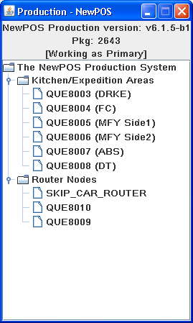
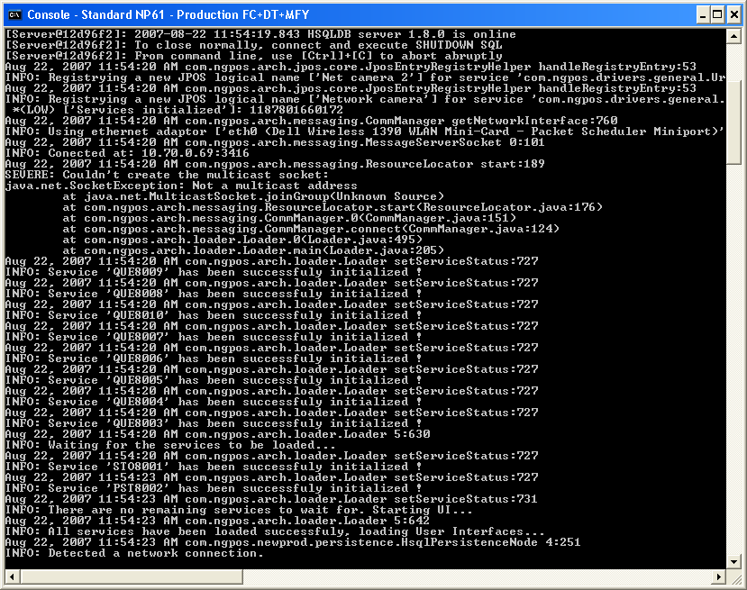
Production
* Example production environment
Notes:
Overview of the topics for the class

Slide 15
Terminology/Topology
WayStation
The Waystation consolidates and persists sales transactions coming from POS and operation logs coming from the Production system. The Waystation is a regular server computer operated by the restaurant manager and concentrates
and distributes POS operations and requests. It is also intended for backup operations and for consolidated reports. This machine runs several Waystation services that provide functions such as:
• keeping a backup of each register accounting records
• collecting statistical data about the restaurant operation, such as operation times received from the Production system
• controlling basic register operations, such as opening and closing the day
• answering queries and commands about the restaurant operation from the back office systems
• monitoring and distributing update packages for configuration or binary changes
Notes:
Overview of the topics for the class

Slide 16
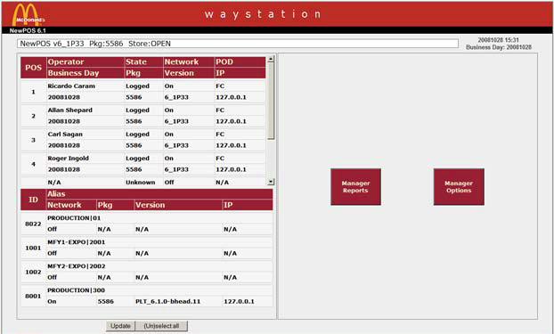
Terminology/Topology
WayStation (continued)
The Waystation services run as a server component, but there is a web client application that works as front end for these services. The following images are some screen samples of this web application -screenshot of Waystation Interface:
Notes:
Overview of the topics for the class

Slide 17
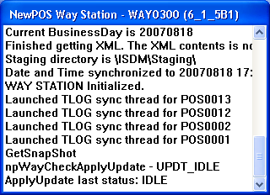
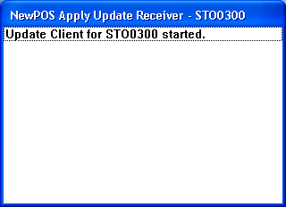
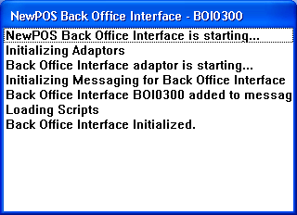
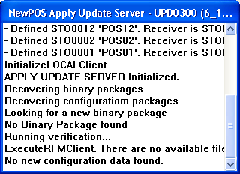
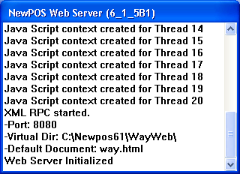
Terminology/Topology
WayStation Services
Notes:
Overview of the topics for the class

Slide 18
Topology
Key Software components
POS
KVS
WayStation
Web Server
Production
Notes:
NewPOS 6.1 Modules
The NewPOS 6.1 suite includes a few different applications, fit for different roles within a restaurant and, therefore, composed of different features. The main applications available in NewPOS 6.1 are: POS, HOT and WAY. Additionally, we also describe RFM, which is a separate application that maintains the restaurant configuration files, sending updates to the restaurant.
POS – Point of Sale
This is the main piece needed to run NewPOS 6.1. The display shows all screens with products and specialty function buttons accessed by the restaurant manager. Sales transactions are performed, stored and transmitted by the POS station to the Way Station for storage and generation of consolidated reports. It can be configured based on required services on each specific workstation. The front counter and drive thru registers have to run the POS service to allow operators execute their sales routines.
POS - Point of Sale
The POS application is responsible for creating and managing sales transactions from customer orders, which is the main activity of a POS system. This application allows the crew members to capture customer orders (by effectively displaying all screens with products and tender options to the crew members, who register the customer selection), storing the information and transmitting the order data to the other modules in the system, so the orders can be prepared, delivered
and accounted for.
Each POS can load different screens and services and/or use different devices, allowing for a flexible combination of features and equipment throughout the restaurant. To name a few, a POS can operate as a simple “over the counter” machine, as part of a series of counter registers, as a drive-through lane register or as a Customer Self Ordering kiosk.
WAY – Way Station
The Way Station is a regular server computer operated by the restaurant manager and concentrates and distributes POS operations and requests. The Way Station is physically located at the back room and controls all communications among POS machines. It is also intended for backup operations and for consolidated reports.
The Way Station is a web-based application that consolidates and persists sale transactions coming from POS and handles the interfacing of NewPOS with a backoffice application, widely used in restaurants to control the restaurant operation (from sales to accounting, from production performances
to raw item stock orders). The WAY was designed to run in the backoffice, in a machine operated by the store manager,
concentrating and distributing POS operations and requests. It is also intended for backup operations
and for consolidated reports, as well as different administrative functionalities used by managers,
such as:
· to back up the state of the POS and Production and restore them after a crash or replacement
· to keep in persistent storage the POS accountings and the consolidated store accounting
· to collect statistical data about the store operation, such as operation times received from Production
· to control the POS operation, opening and closing the POS
· to control the cash received and the bank deposits
· to accept queries about the store operation from the back office and respond to them
· to monitor changes in the data maintained by the RFM, updating the POS and Production

Slide 19
KVS -Online
Notes:
Overview of the topics for the class

Slide 20
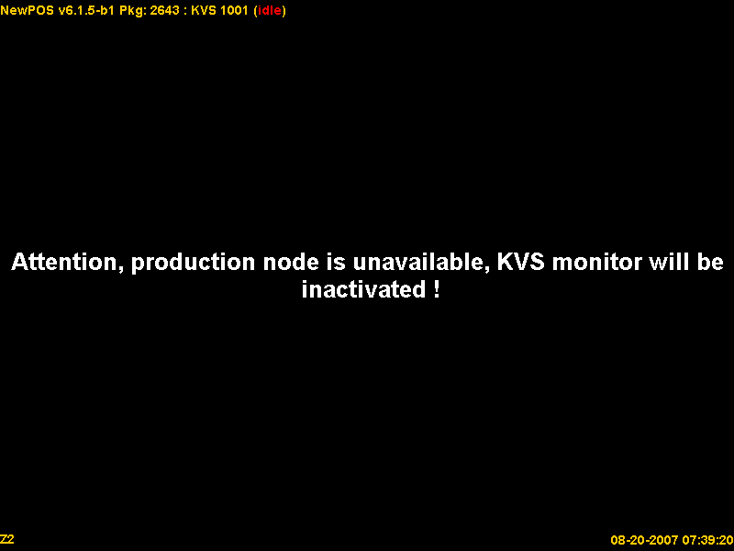
KVS -Offline
Notes:
Overview of the topics for the class

Slide 21
NewPOS 6.5 Training – Restaurant Terminlogy and Topology Overview
Support QA For McDonald’s
Discussion
Any Questions?

